Slide 1
Camunda Cloud
Code Studio
hosted by your favorite Developer Advocates

Slide 2


Your hosts for this session
Thomas Heinrichs
Developer Advocate
Josh Wulf
Developer Advocate

Slide 3
About Camunda and this workshop
Get to know each other and brainstorm processes
Break
Let’s try out Camunda Cloud
Deploying a process with user tasks
Implementing your first client for Cloud
Break
Adding more complexity to your process
Generate awesome dashboards in Optimize
Hangout & Beer
End

Slide 4
Automate any process anywhere
SaaS solution for process automation
Ideal for cloud native architectures and use cases
Leverage diverse technology stacks
Orchestrate diverse endpoints
Available on demand, at cloud scale

Slide 5
About Camunda
Camunda innovates process automation with a developer-friendly approach that is standards-based, highly scalable and collaborative for business & IT
Employees
Worldwide Offices
2008
100.000+
450+
300+
6
Founded
Community Members
Enterprise Customers

Slide 7
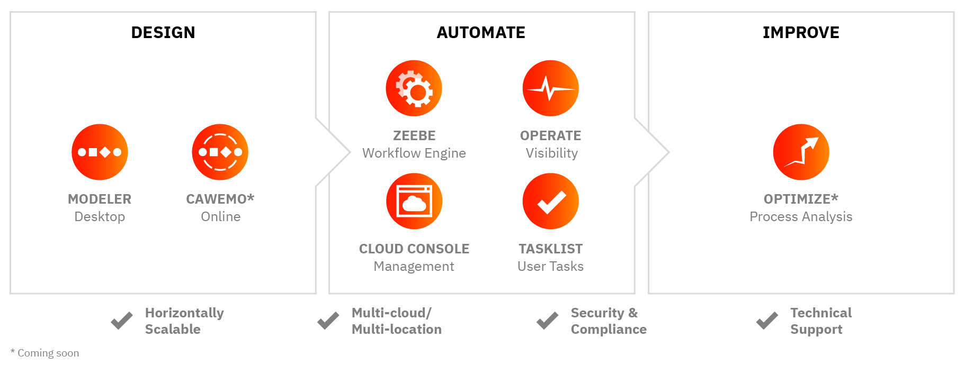
Components of Camunda Cloud

Slide 8
Get to know each other in breakout rooms
Exercise:
What process would you choose to help the health department to get more efficient?

Slide 9

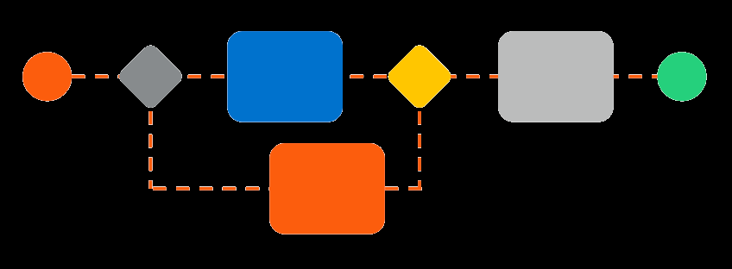
Let’s start modelling your ideas!

Slide 10

Try out Camunda Cloud

Slide 11
Deploying a process with user tasks
Implementing your first client for Cloud
Adding more complexity to your process
Generate awesome dashboards in Optimize

Slide 12

Now you have earned yourself a Beer
<survey>
Leave some Feedback!
Well done and thanks a lot for participating in this workshop!

